Slide 1
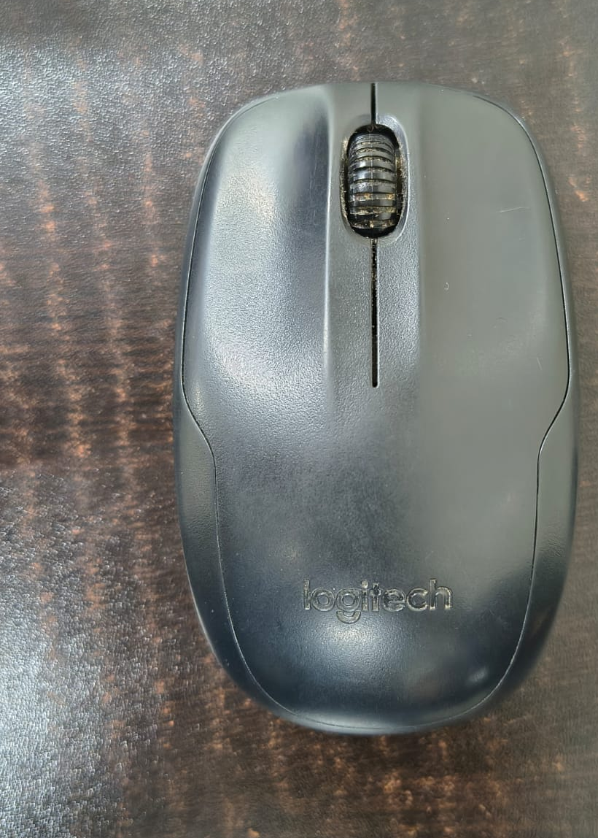
REVERSE ENGINEERING
ACTIVITY REPORT
LOGITECH M150 WIRELESS MOUSE
GROUP No. : 40
Members - Agrim Vasishth , Vivek Banoula , Dixit Raj ,
Shourya Pratap Singh , Tarnav Singh
OBJECTIVE: To inspect the Logitech M150, identify its visible hardware, and explain how optical tracking, control, wireless communication and power management work together.
The mouse is a compact wireless pointing device using optical tracking, a control IC, 2.4 GHz communication and battery power. Dimensions recorded in the report: 80 g; 37 mm high × 62 mm wide × 102 mm deep.
PROJECT OBJECTIVE
To inspect the mouse, identify its visible hardware and explain how optical tracking, control, wireless communication and battery power work together.
Actual mouse before teardown

Slide 2
1. COMPONENTS AND TOOLS USED
OBSERVED PARTS
TOOLS / DOCUMENTATION
• Small Phillips screwdriver and plastic opening tool
• Phone/camera for each teardown stage
• Tweezers and magnifier for component markings
• ESD-safe work surface and basic precautions
• Notebook/table for reference designators and observations
• KiCad for a conceptual schematic; actual OEM firmware and full pinout were not available
• Main PCB and RF/control IC (visible marking noted)
• Optical navigation sensor and lens opening
• Left/right click switches and scroll-wheel mechanism
• Crystal/resonator, ceramic capacitors and zero-ohm links
• Battery contacts, LED and USB receiver (separate unit)
• Plastic shell, clips and internal supports

Slide 3
2. CIRCUIT DIAGRAM — CONCEPTUAL RECONSTRUCTION
Battery
1 × AA
VBAT
SW1
Power
VDD rail
(local supply)
U1 — CONTROL / RF IC
processing + 2.4 GHz link
PCB antenna
RF link
C1 100 nF
sensor bus*
GND
Left / right
click switches
Optical sensor
image / motion data
Scroll encoder /
wheel input
\

Slide 4
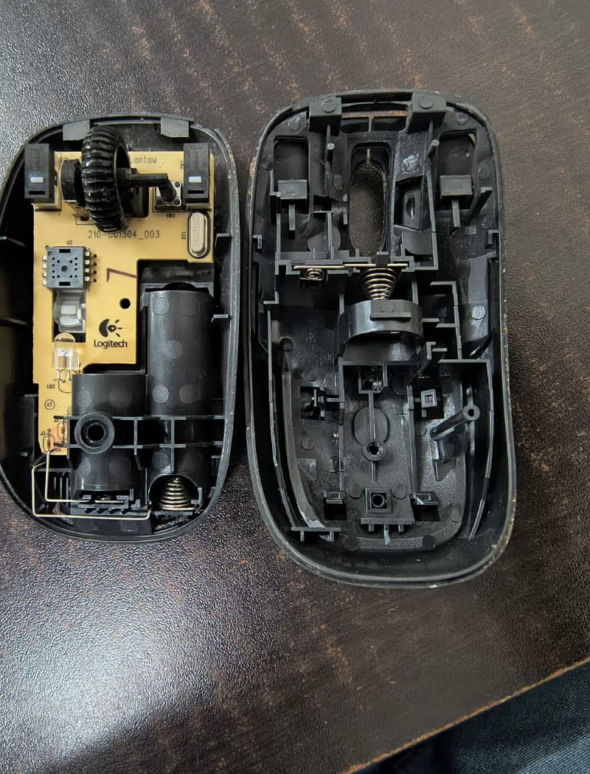
3. INTERNAL SUBSYSTEMS & SIGNAL FLOW
OPTICAL TRACKING — An LED illuminates the surface and a CMOS sensor captures successive surface images. Changes between images are interpreted as X/Y movement.
MCU / CONTROL — The microcontroller processes movement and button information. It also handles switch debouncing and prepares clean digital data for transmission.
2.4 GHz RF — Processed information is converted into wireless packets and sent to the USB receiver. The report identifies frequency-hopping operation within this subsystem.
POWER MANAGEMENT — Battery energy is regulated and distributed while the system changes power states depending on user activity.
Overall signal chain: physical movement / button input → optical and mechanical sensing → MCU processing → wireless packet → USB receiver → computer.
Analysis: the important part is not any single component; it is the coordination of all four subsystems under small size and low-power constraints.
Teardown view — internal mechanical structure and PCB

Slide 5
4. EXTERNAL FEATURES & PHYSICAL INSPECTION
Physical construct: wireless USB-dongle based mouse.
The first step is observation before opening the product. The external form already gives clues about the intended use and internal architecture.
• Compact enclosure: the 102 × 62 × 37 mm size places strong limits on how the battery, switches, sensor, controller and RF hardware can be arranged.
• User interface: buttons and scroll control provide mechanical inputs, while the optical tracking area senses movement over a surface.
• Wireless interface: a USB receiver is used instead of a permanent cable, making the mouse portable and reducing desktop cable clutter.
Engineering inference: even without opening it, the product can be viewed as a small embedded system combining mechanical input, sensing, processing, communication and power management.
External inspection — Logitech mouse

Slide 6
5. MODES OF OPERATION & POWER MANAGEMENT
ACTIVE MODE — Full power is available for real-time tracking and click transmission while the user is actively using the mouse.
STANDBY MODE — After a short period of stillness, sensor activity is reduced while the system remains ready to respond quickly.
DEEP SLEEP MODE — After longer inactivity, most internal functions enter a very low-power state. Movement or a physical input can wake the device.
PAIRING MODE — The wireless subsystem becomes active while establishing communication with the USB receiver.
Why this matters: a battery-powered mouse cannot stay at maximum activity all the time. The designer has to balance responsiveness against energy consumption.
Engineering trade-off: aggressive sleep saves more energy but can increase wake-up delay; remaining active gives better readiness but reduces battery life.

Slide 7
6. PRODUCT EVOLUTION
EARLY MECHANICAL BALL MICE — X/Y rollers were driven by a rubberized ball. They provided basic coordinate tracking but had mechanical wear and contamination problems.
EARLY OPTICAL / INFRARED WIRELESS — Optical sensing removed many moving tracking parts. Early optical systems could require suitable surfaces, while early wireless links had limitations such as line-of-sight and signal lag.
SECOND GENERATION 2.4 GHz RF — Standard 2.4 GHz wireless communication made desktop use more practical and reduced dependence on line-of-sight positioning. Optical sensors also became more usable on ordinary opaque surfaces.
MODERN OFFICE MICE — Compact receivers, improved optical sensors and intelligent power management combine mobility, tracking and battery efficiency.
Main pattern in the evolution: remove mechanical failure points, improve wireless usability, reduce receiver size, improve sensing and control power consumption.

Slide 8
7. CURRENT TECHNOLOGIES & ENGINEERING ANALYSIS
INTELLIGENT POWER-SAVING — Hardware/firmware timing allows automatic transitions between Active, Standby and Deep Sleep, reducing idle battery drain.
ADAPTIVE FREQUENCY-HOPPING (FHSS) — The 2.4 GHz subsystem can change channels in the ISM band to reduce the effect of nearby wireless interference.
SWITCH DEBOUNCING — Mechanical switches can create several rapid electrical transitions around one physical press. Firmware filtering helps interpret the event as one intended click.
MAJOR TRADE-OFFS:
• Power vs performance: higher sensor/RF activity improves readiness but consumes more energy.
• Wireless mobility vs interference: removing the cable introduces radio interference as a design concern.
• Accuracy vs surface compatibility: optical tracking works well on many surfaces but can struggle on reflective, glossy or transparent glass.
• Size vs integration: electronics, battery and mechanical parts must fit within a compact enclosure.

Slide 9
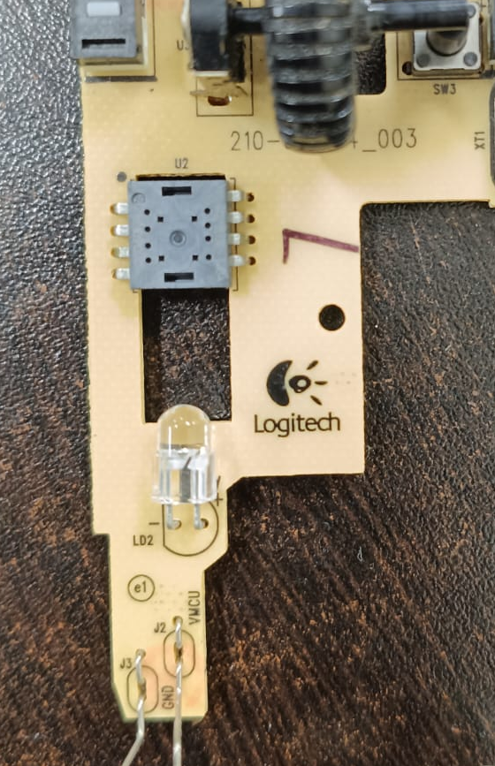
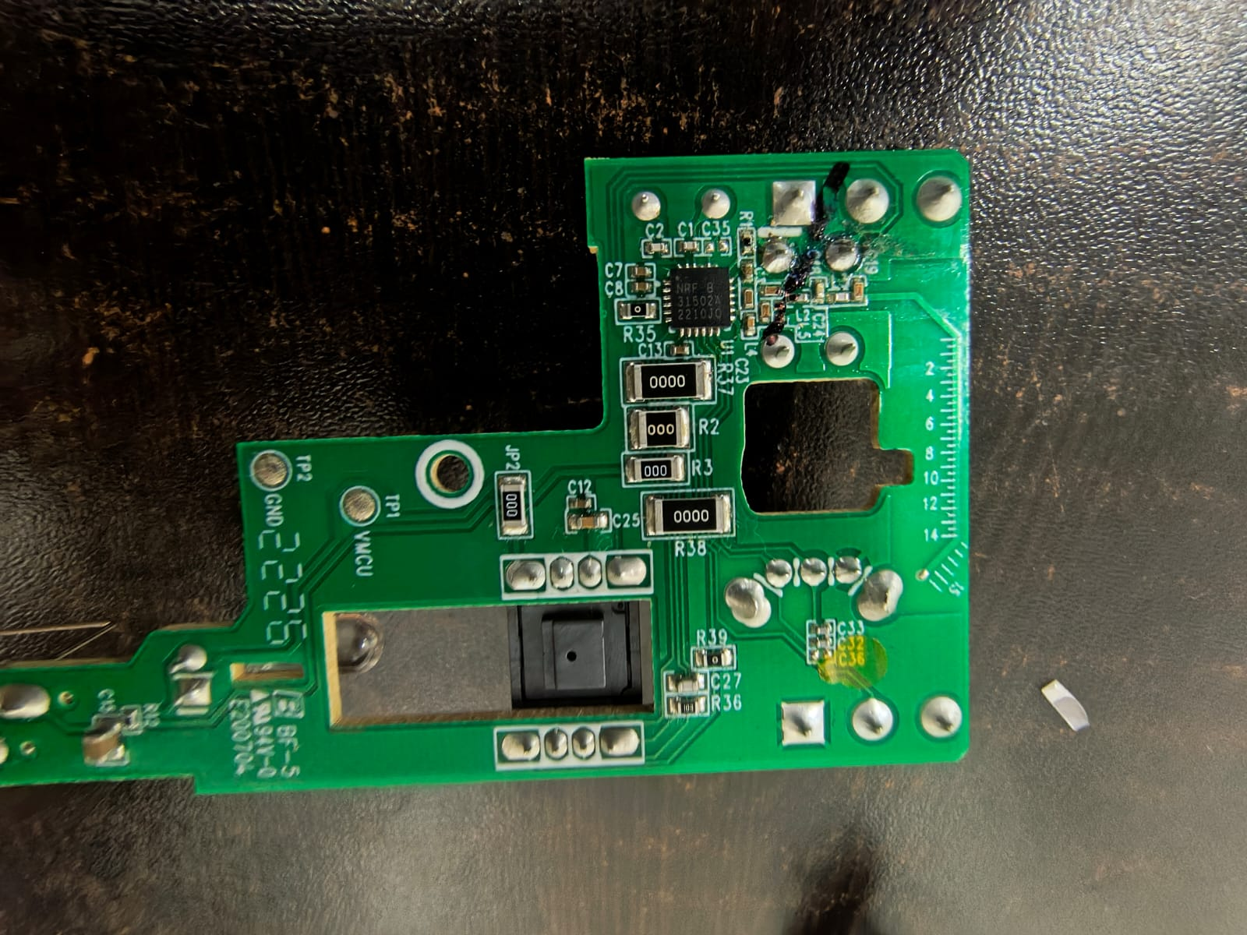
8. TEARDOWN & COMPONENT FUNCTION ANALYSIS
Ref | Component | Role
U1 | 20-pin QFN IC, marked "NRF 31502A 2210JQ" | 2.4 GHz RF transceiver/MCU (Nordic nRF-family type). The date code suggests it was made in week 10 of 2022.
Optical sensor (black 8-pin package over the cutout) | Optical navigation sensor, likely PixArt-type | Tracks surface movement using an LED and lens
R2, R3, R37, R38, JP2 | Zero-ohm links, marked "000" and "0000" | Configuration jumpers for design variants
C1, C2, C7, C8, C12, C13, C25, C27, C33 and others | Ceramic SMD capacitors | Power decoupling and filtering around the RF IC and sensor
TP1 (VMCU), TP2 (GND) | Test points | Probing the supply rail and ground during testing and programming
Pad groups (round and square solder pads) | Switch, scroll-encoder and battery/wire connections | Contacts for the micro-switches, scroll wheel and power
Large cutout (right) | Scroll-wheel slot | Holds the wheel and encoder assembly
PCB close-up
Component-side PCB

Slide 10
9. RECONSTRUCTED CIRCUIT / FUNCTIONAL DIAGRAM
Logitech M150 teardown — functional relationships inferred from the observed PCB and report
POWER
CONTROL
SENSING / INPUT
WIRELESS LINK
AA battery
(VBAT)
nRF-family IC
(marking observed on PCB)
Optical sensor
(package over cutout)
2.4 GHz RF transmission
Power rail /
regulation
Left / right
switches
USB receiver
XT1 crystal / clock
C1, C2, C7…
Decoupling caps
Scroll wheel
mechanism
Processes inputs and
handles radio functions
Computer / pointer movement

Slide 11
10. SIMULATION CIRCUIT (SIMPLIFIED MODEL)
A small demonstrator circuit for showing input detection and status indication; not the proprietary mouse electronics
3.3 V supply
(VCC)
MCU / logic block
(simulation)
Status LED
SW1: Left click
GPIO input
SW2: Right click
GPIO input
SW3: Scroll input
GPIO input
R1
330 Ω
In KiCad, use a generic MCU symbol, three normally-open switches with pull-ups/pull-downs, and an LED with a series resistor. A true RF/optical-sensor simulation is outside this simplified model; label it clearly as a functional demonstration.

Slide 12
11. FINAL CONCLUSIONS
LEVEL 1 — OBSERVATION: The product is a compact wireless optical mouse using a USB receiver.
LEVEL 2 — IDENTIFICATION: Its main functional areas are optical tracking, control/MCU processing, 2.4 GHz RF communication and power management.
LEVEL 3 — SPECIFICATION: The report provides physical dimensions and describes the technologies, operating modes and development stages. Exact internal IC specifications require physical evidence.
LEVEL 4 — FUNCTIONAL UNDERSTANDING: Movement and button actions become processed digital information, are transmitted wirelessly and are managed through different power states.
LEVEL 5 — ENGINEERING REASONING: The design choices balance usability, reliability and battery life against size, cost, interference and surface limitations.
Final conclusion: reverse engineering is not simply identifying parts. It is understanding the engineering decisions that connect mechanical design, sensing, embedded processing, wireless communication and power management into one working product.

